Slide 1
Triviagame – code explanation

Slide 2
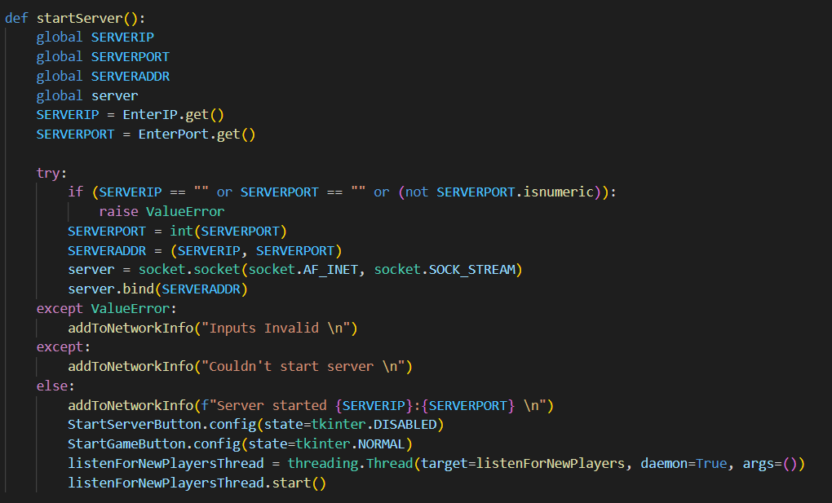
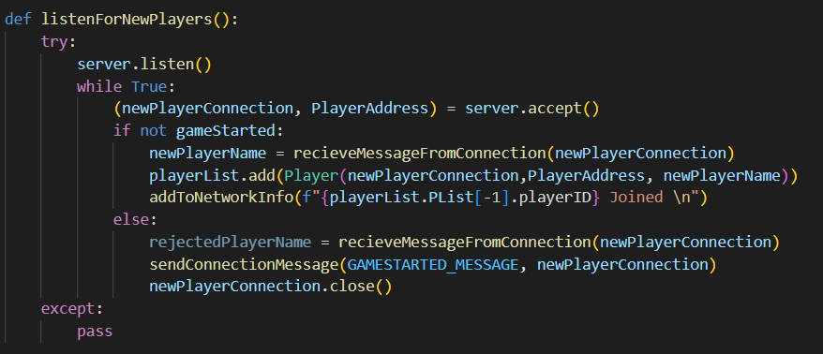
Starting Server
Server starts a TCP socket and accepts all connections. If the game hasn’t started creates a player object with the address of the connection and adds it to the list of players. Or notifies the client that the game is ongoing and closes the connection.

Slide 3
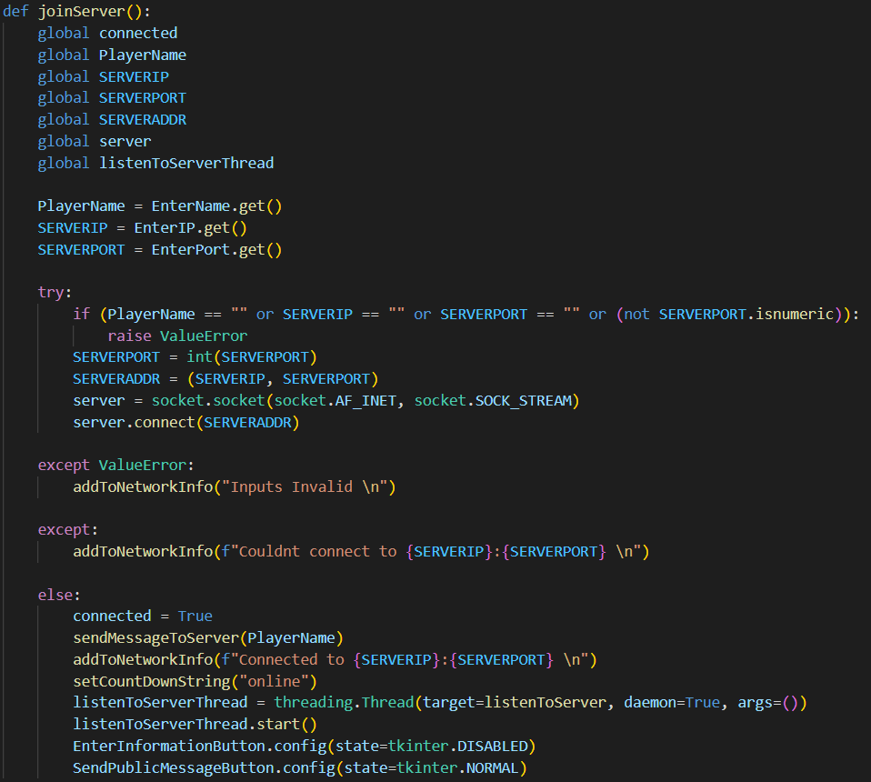
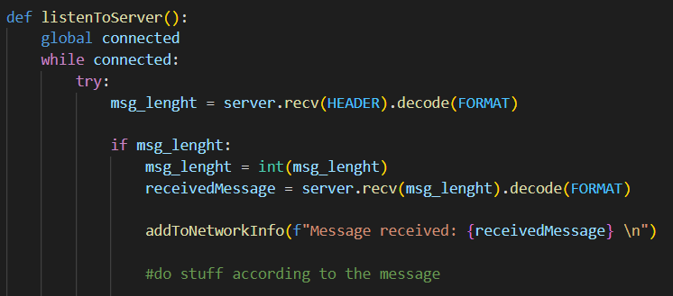
Starting Client
Client tries to connect to the given address. If it can it starts listening to the server and responds accordingly to received messages

Slide 4

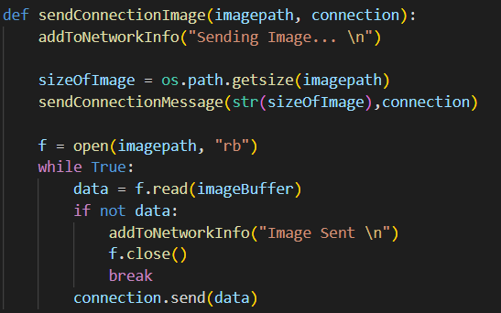
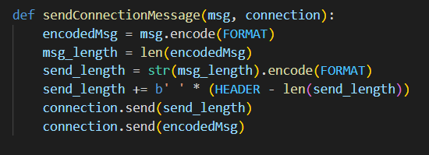
How Does Server Send Messages And Images
We want to be able to send messages of any size.
So, we first send the length of the message in a HEADER sized message that the client expects and then we send the actual message which the client waits to receive.
This code can be used to send a file of any kind. We first send the size of the file so that the client knows when it received all parts of the image. Then we send imageBuffer sized chunks of the image until we send every byte.
We can’t send all the image at once since there is a limit how much data can be carried at once.

Slide 5
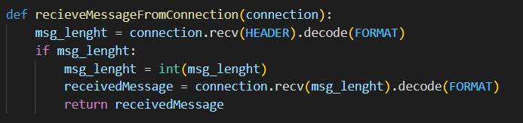
How Does Server Send Messages And Images
This code can be used to send a file of any kind. We first send the size of the file so that the client knows when it received all parts of the image. Then we send imageBuffer sized chunks of the image until we send every byte.
We can’t send all the image at once since there is a limit how much data can be carried at once.
We want to be able to send messages of any size.
So we first send the length of the message in a HEADER sized message that the client expects and then we send the actual message which the client waits to receive.

Slide 6
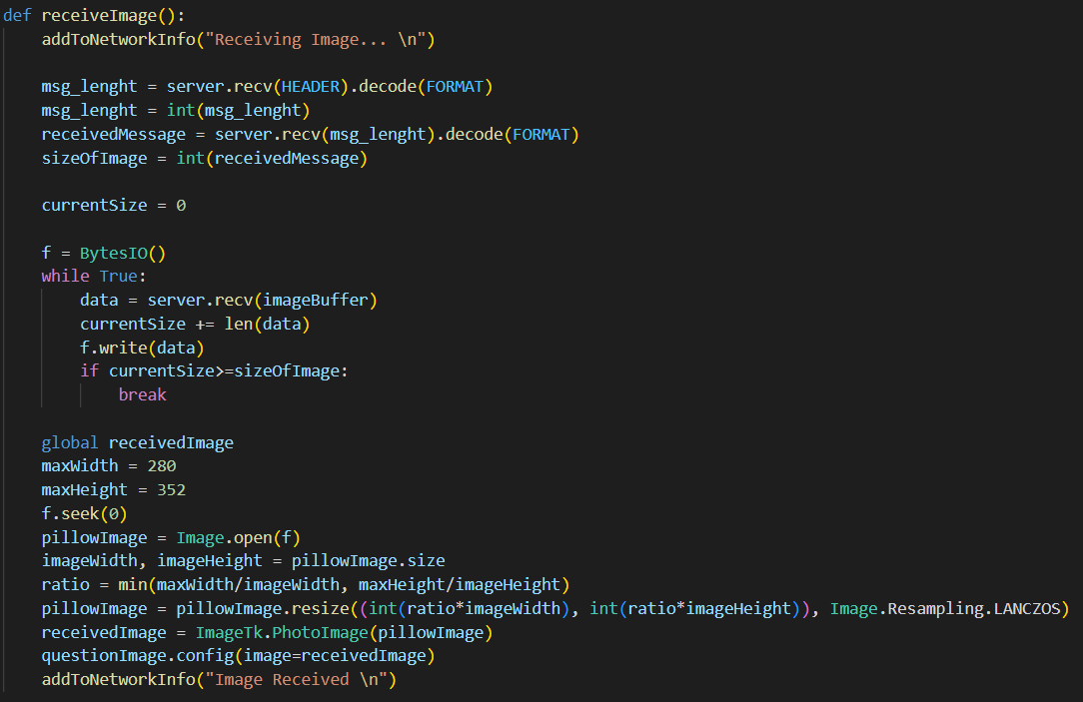
How Does Client Receive And Display Images
First the size of the Image is received. Until that many bites are received the bytes are written unto BytesIO object. The BytesIO object is then given as a file for Pillow (an Imaging Library) to open. The Pillow image is resized to be fitted inside the tkinter label while retaining its aspect ratio.

Slide 7
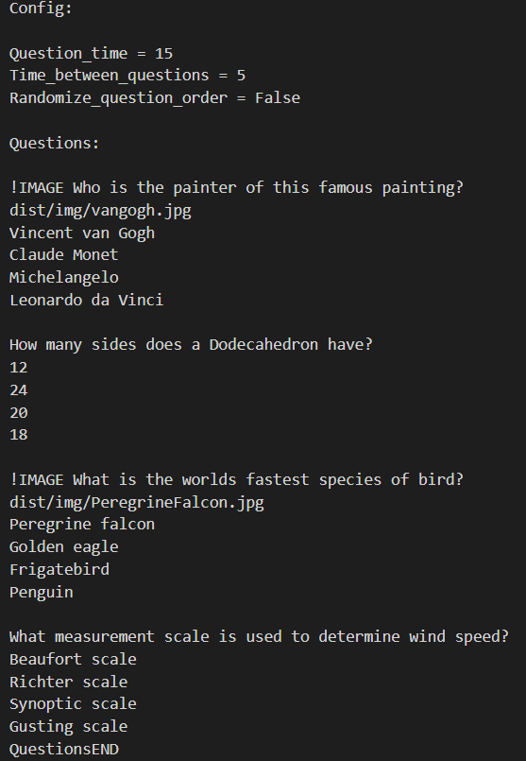
How Are Questions Sent?
config.txt
The config file is read by the server. And divided into two lists:
configList and questionDataList. Configurations are read and applied to the game and there are default configs if no config is given.
If a question starts with “!IMAGE” that means the question should be asked with the corresponding image. The path for this image should be given in the next line.
The correct answer should be the next line and the remaining 3 incorrect answers should be the next lines.
The answers are shuffled individually before being sent to the clients.

Slide 8
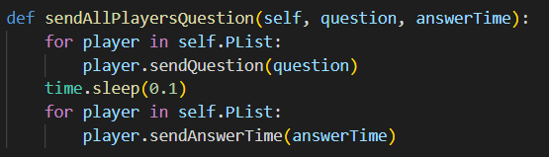
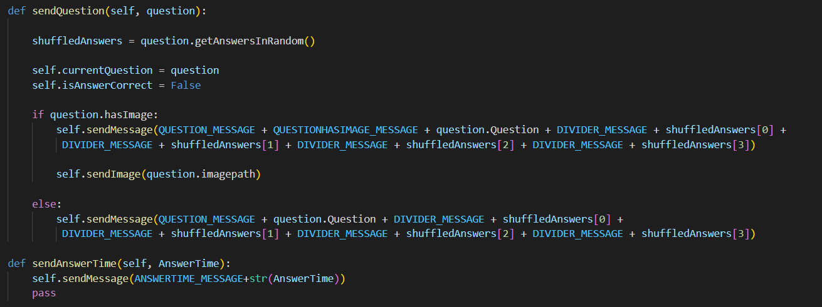
How Are Questions Sent?
Questions and their images are sent to every player. After waiting a small amount how much time the client has for answering is sent. Starting the countdown.

Slide 9
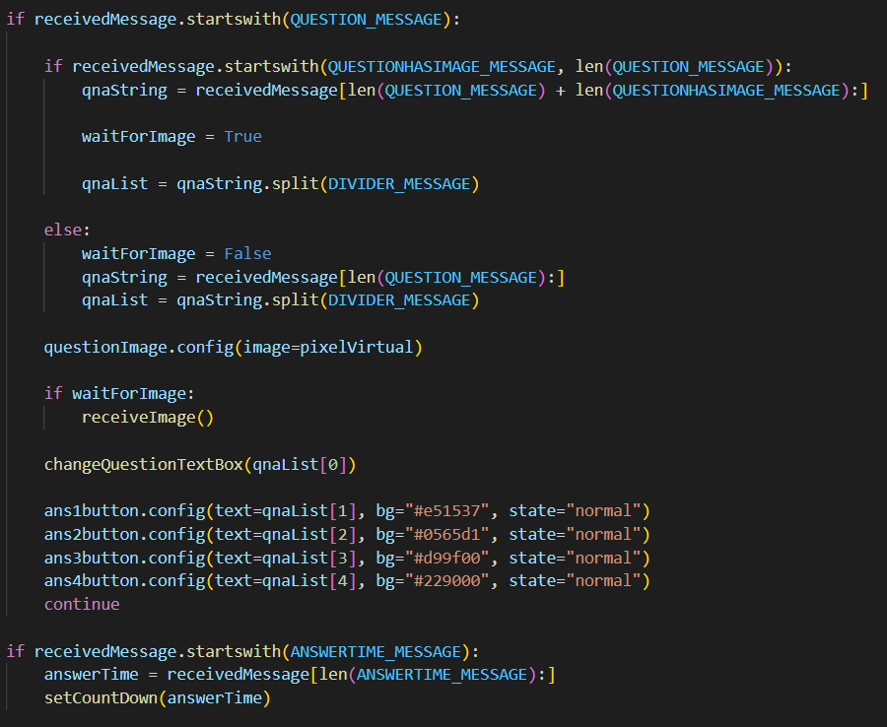
Client Side For Receiving Questions

Slide 10
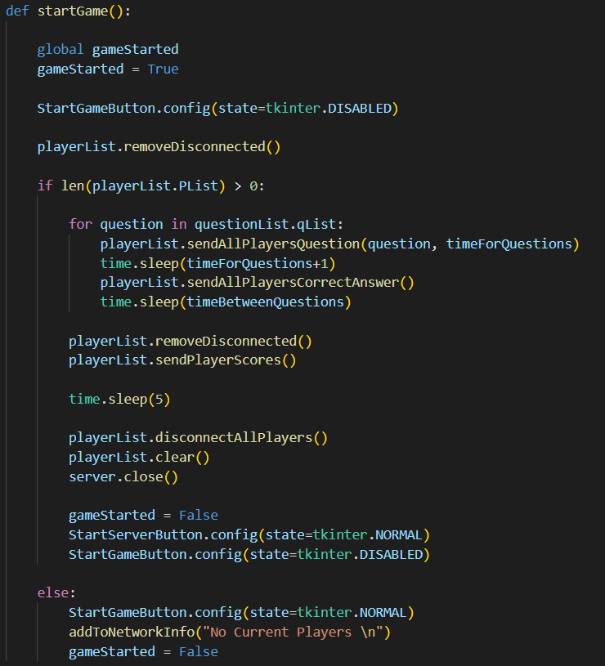
Finally, The Start Button Is Clicked
All players that joined the server and disconnected are removed from the playerList. If there are no players connected the game doesn’t start. A question are sent and after the correct amount of time answers to those questions are sent. After a waiting period the next questions are sent. After all the questions are finished, scores are sent to the still connected players. The scores are displayed for 5 seconds and then every player is disconnected before the server socket is closed. The game can be started again.

